Slide 1

[Samsung PRISM] Preliminary Discussion
Develop a Quality Assurance framework for Image Generation Models
Team
College Professor(s): Dr. Antony Louis Piriyakumar, Prof Geetha R
Students:
Ayush Kumar Singh / ayushkumar.20aiml@cambridge.edu.in
Akash V / akash.20aiml@cambridge.edu.in
Girish Chandra Saxena / chandrasaxena.20aiml@cambridge.edu.in
P Aaditya / padditiya.20aiml@cambridge.edu.in
Department: AI&ML
Date: 28 Nov 2023

Slide 2


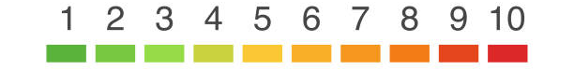

Develop a Quality Assurance framework for Image Generation Models
Problem Statement
Expectations
Context
Undertaken Tasks
Develop a comprehensive framework for conducting equitable and standardized comparisons of image generation models, ensuring 'apple-to-apple' assessments. This framework should establish consistent evaluation metrics, benchmark datasets, and evaluation protocols to facilitate a fair and meaningful comparison of various image generation techniques. The goal is to advance the field of computer vision by providing a reliable means of model assessment and selection.
Exhaustive Literature Survey of Image Generation Metrics [CLIP, FID, SFS, CHAIR & etc]
Develop a fixed framework for Quality Assurance & Identify SOTA Benchmark Levels
Statement
Currently Image Generation Models’ QA is mainly subjective in Nature, Building a Framework consisting of SOTA metrics will enable easier comparison of Image Generation Models
KPI
Framework should consider all possibilities & parameters of the Image Generation Space
Worklet Details
Pranal Prasad Dongare
+91-7022250561
pranal.p@samsung.com
2
6
Timeline
Tushar Madaan
+91-9205301569
tushar.m2@samsung.com
Kick Off < 1st Month >
Milestone 1 < 2nd Month >
Duration (Months)
Members Count
Mentors
Problem Briefing
Check Feasibility
R&D on Image Generation Metrics
Identify a framework which accurately evaluates Image Generation Models
Pre-Requisite
Familiar with Coding predominantly Python
Familiar with Diffusion Models & Evaluation Metrics
Complexity
Notes:
https://nv-tlabs.github.io/DIB-R/

Slide 3
Work-let Name: Develop a Quality Assurance framework for Image Generation Models
Worklet Details
Worklet ID: 23RSG25
College Name: Cambridge Institute of Technology, Bangalore
KPIs achieved till now
Any Challenges/ Issues faced
Few research papers for literature survey have been studied.
Implemented Metrics – CLIP and FID.
Didn’t find any CHAIR metric implementation
Next Steps
Key Achievements/ Outcome till now
More research paper for literature survey to be studied.
Implementing other metrics
Implemented Metrics – CLIP and FID.
Date:28 Nov 2023

Slide 4
Literature survey and study
L 1: ViLBERTScore: Evaluating Image Caption Using Vision-and-Language BERT
Innovative Evaluation: This paper creates a new way to judge image captions by using both image and text details instead of just focusing on text like older methods.
ViLBERT Technique: It uses ViLBERT to understand the meaning of words in captions with respect to the images. This helps compare how well captions match the visuals.
Better Agreement with People: When tested on various datasets, this method showed much better agreement with what people thought about the captions compared to existing ways of judging.

Slide 5
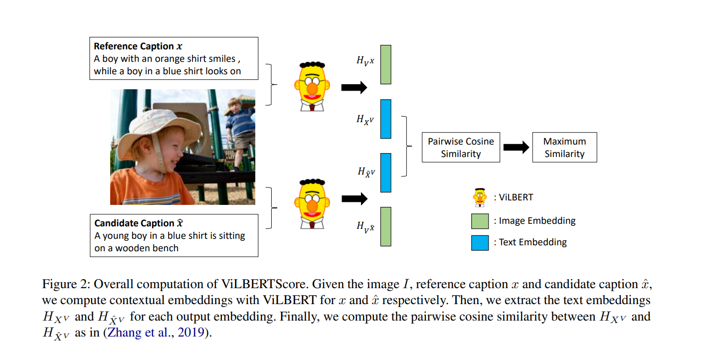
Literature survey and study

Slide 6
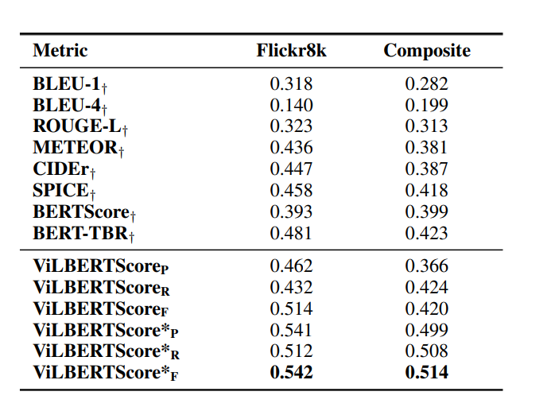
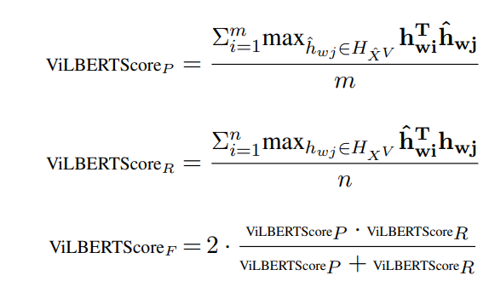
Literature survey and study
Kendall Correlation between human judgments and various metrics

Slide 7
Literature survey and study
L 2: InfoMetIC: An Informative Metric for Reference-free Image Caption Evaluation
Enhanced Evaluation: InfoMetIC improves image captioning evaluation by offering detailed feedback. It pinpoints errors in specific words and missing image details within captions.
Fine and Coarse Evaluation: It provides both detailed (word-level) and overall scores, capturing nuances missed by single-score metrics.
Human-Like Assessment: Its scores align better with human judgment, improving upon existing metrics that lack detailed feedback.
Specific Issue Identification: InfoMetIC identifies inaccurate words and unmentioned image regions, allowing a deeper understanding of caption quality.
Dataset and Validation: The paper constructs a token-level dataset to demonstrate InfoMetIC's effectiveness in pinpointing caption flaws, likely serving as a benchmark for evaluation.

Slide 8
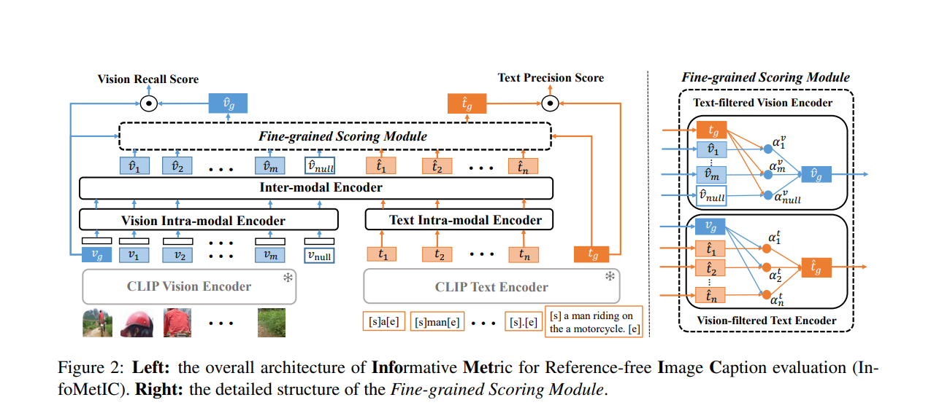
Literature survey and study

Slide 9
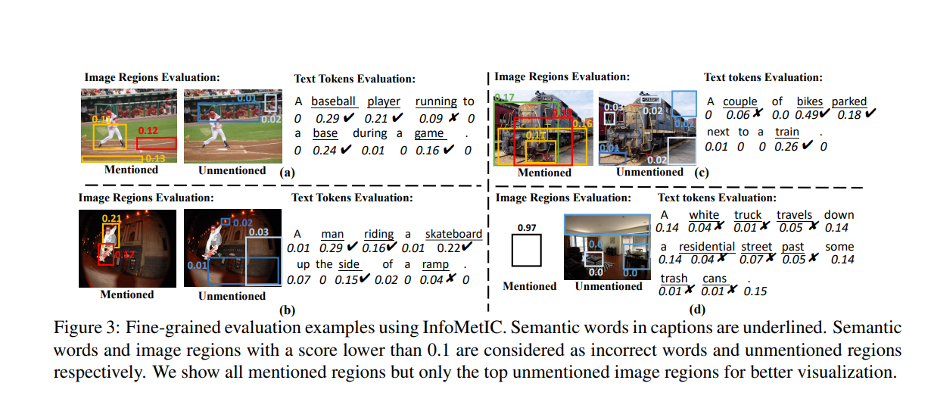
Literature survey and study

Slide 10
Literature survey and study
L 3: TIGEr: Text-to-Image Grounding for Image Caption Evaluation
Comprehensive Assessment: TIGEr, a new metric, evaluates image captions considering both image content and human-generated captions, not just text matches like other metrics.
Bias Mitigation: It addresses biases in existing metrics caused by incomplete reference captions and language ambiguity, providing a more balanced evaluation.
Better Alignment with Humans: Tests show TIGEr's scores match more closely with what people think about captions, making it a more reliable evaluation tool for image captioning.

Slide 11
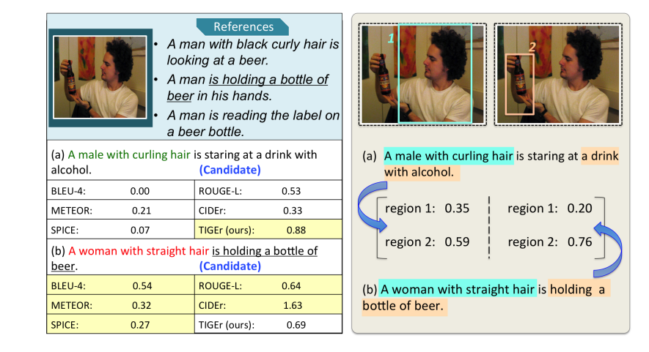
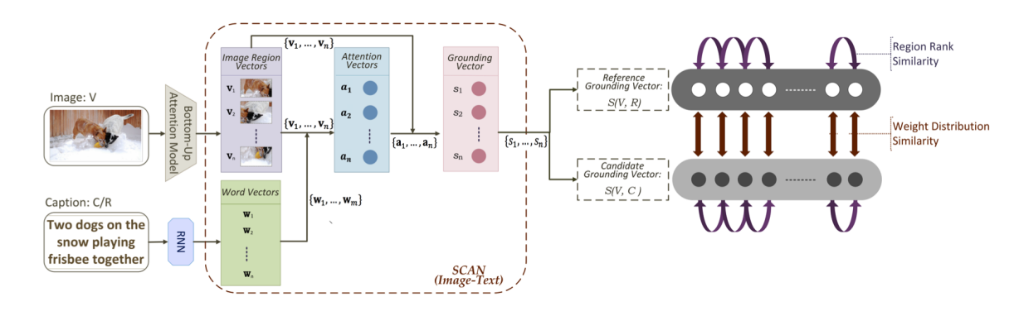
Literature survey and study

Slide 12
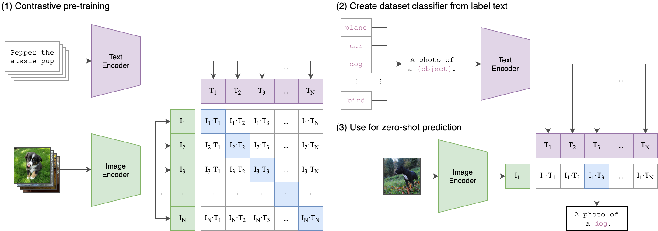
IMPLEMENTATION OF METRICS:
CLIP:
We utilized a pre- trained CLIP Model text – image embedding to compare-
1. one image with multiple prompts
2. Multiple images with one prompt
We deviated from regular method of using cosine similarity with SoftMax to predict classes, instead we utilized the models text- image embedding and computed score between text and image.
Currently we are utilizing the smallest pre – trained CLIP models as authors of the models have restricted the use of pre trained models outside the hugging face environment.
Current size of pre trained embedding-
Available models:
1. OpenAI- Clip-vit-large-patch 14 (428M parameters)
2. LAION- CLIP-vit -bigG-14-lian2B-39B (2.32B parameters)

Slide 13
Contd…
FID:
The Frechet Inception Distance score, or FID for short, is a metric that calculates the distance between feature vectors calculated for real and generated images.
The score summarizes how similar the two groups are in terms of statistics on computer vision features of the raw images calculated using the inception v3 model used for image classification.
Lower scores indicate the two groups of images are more similar, or have more similar statistics, with a perfect score being 0.0 indicating that the two groups of images are identical.

Slide 14
Queries
Challenges :
1. Didn’t find any CHAIR metric implementation
DO we need to do from scratch or focus on other metrics.

Slide 15
Thank you

